Slide 1
Artificial intelligence & MACHINE LEARNING
CO-2 Session no: 5
Topic: IMPLEMENTING INFERENCING - Forward chECKING

Slide 2
Introduction to INFERENCING IN AI
Inferencing in AI:
Inferencing is a fundamental process in artificial intelligence, where machines make logical deductions and draw conclusions from available information.
It is the core of intelligent decision-making and problem-solving in AI systems.

Slide 3
INFERENCE ENGINE
The inference engine is the component of the intelligent system in artificial intelligence, which applies logical rules to the knowledge base to infer new information from known facts. The first inference engine was part of the expert system. Inference engine commonly proceeds in two modes, which are:
Forward checking
Backward checking

Slide 4
Forward – chECKING
Forward checking is a crucial constraint propagation algorithm used in the field of artificial intelligence, particularly in the context of constraint satisfaction problems (CSPs).
It is a powerful technique that helps to efficiently prune the search space and reduce the number of backtracking steps required to find a solution. The fundamental idea behind forward checking is to detect and eliminate infeasible variable assignments as early as possible in the search process, thereby improving the overall performance and efficiency of the problem-solving algorithm.

Slide 5
PRINCIPLES OF Forward – checking
Early Elimination of Infeasible Assignments: The primary principle of forward checking is to detect and eliminate infeasible variable assignments as early as possible in the search process.
Constraint Propagation: Forward checking actively propagates the consequences of each variable assignment throughout the remaining unassigned variables. This process of constraint propagation ensures that the impact of a decision is felt across the entire problem domain, allowing the algorithm to make informed choices and avoid dead-ends.

Slide 6
Continued…..
Efficient Backtracking: When the forward checking algorithm identifies an infeasible assignment, it triggers a backtracking process to explore alternative solutions. This backtracking is guided by the principles of forward checking, as the algorithm can efficiently pinpoint the decision points that led to the dead-end, allowing it to backtrack to the most appropriate location in the search tree.

Slide 7
Advantages of forward checking
Reduced Backtracking: One of the primary advantages of forward checking is its ability to minimize the amount of backtracking required. By quickly detecting and pruning dead-end paths, the algorithm avoids wasted effort and unnecessary backtracking, leading to a more streamlined and efficient search for solutions.
Improved Constraint Propagation: The forward checking algorithm excels at propagating the consequences of variable assignments throughout the remaining unassigned variables.
Enhanced Scalability: : Forward checking demonstrates excellent scalability, as it can effectively handle problems with increasing complexity and size. Its ability to efficiently prune the search space and minimize backtracking makes it well-suited for tackling large-scale constraint satisfaction problems.

Slide 8
Example of forward checking
The law says that it is a crime for an American to sell weapons to hostile nations. The country Nono, an enemy of America, has some missiles, and all of its missiles were sold to it by Colonel West, who is American.
Prove that Col. West is a criminal

Slide 9
First order definite clauses
It is a crime for an American to sell weapons to hostile nations:
American(x) ∧ Weapon(y) ∧ Sells(x,y,z) ∧ Hostile(z) ⇒ Criminal(x)
Nono has some missiles
∃x Owns(Nono,x) ∧ Missile(x)
Owns(Nono,M₁) ∧ Missile(M₁)
All of its missiles were sold to it by Colonel West
Missile(x) ∧ Owns(Nono,x) ⇒ Sells(West,x,Nono)

Slide 10
Example
Missiles are weapons:
Missile(x) ⇒ Weapon(x)
An enemy of America counts as “hostile”:
Enemy(x,America) ⇒ Hostile(x)
West is American
American(West)
The country Nono is an enemy of America
Enemy(Nono,America)

Slide 11
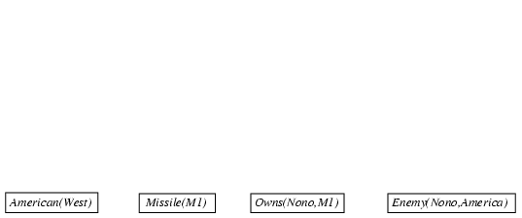
Forward checking proof
American(x) ∧ Weapon(y) ∧ Sells(x,y,z) ∧ Hostile(z) ⇒ Criminal(x)
Owns(Nono,M₁) ∧ Missile(M₁)
Missile(x) ∧ Owns(Nono,x) ⇒ Sells(West,x,Nono)
Missile(x) ⇒ Weapon(x) Enemy(x,America) ⇒ Hostile(x)
American(West) Enemy(Nono,America)

Slide 12
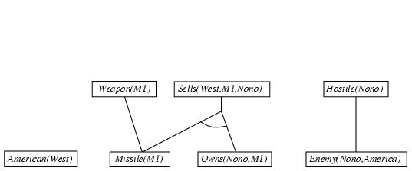
Forward checking proof
American(x) ∧ Weapon(y) ∧ Sells(x,y,z) ∧ Hostile(z) ⇒ Criminal(x)
Owns(Nono,M₁) ∧ Missile(M₁)
Missile(x) ∧ Owns(Nono,x) ⇒ Sells(West,x,Nono)
Missile(x) ⇒ Weapon(x) Enemy(x,America) ⇒ Hostile(x)
American(West) Enemy(Nono,America)

Slide 13
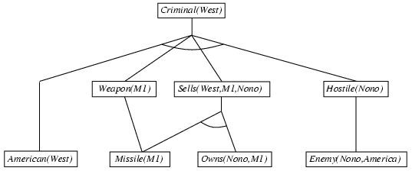
Forward checking proof
American(x) ∧ Weapon(y) ∧ Sells(x,y,z) ∧ Hostile(z) ⇒ Criminal(x)
Owns(Nono,M₁) ∧ Missile(M₁)
Missile(x) ∧ Owns(Nono,x) ⇒ Sells(West,x,Nono)
Missile(x) ⇒ Weapon(x) Enemy(x,America) ⇒ Hostile(x)
American(West) Enemy(Nono,America)

Slide 14
Properties of forward checking
Forward checking approach is also called as data-driven as we reach the goal using available date.
It is a down-up approach, as it moves from bottom to up.
It is a process of making a conclusion based on known facts or data, by starting from the initial state and reaching the goal state.
Forward Checking approach is mainly used in applications like object recognition, routine decisions, used in expert system such as CLIPS, business production rule systems.

Slide 15
summary
Forward checking is a powerful inferencing technique in AI and ML that helps reduce the search space in CSPs, making problem-solving more efficient.
By understanding and implementing forward checking, you can tackle a wide range of CSPs with improved performance and reliability.
In this session the concept of forward checking is discussed in details and shown how forward checking is used to prove the first order logic statements.

Slide 16

SELF ASSESSMENT QUESTIONS
Which algorithm will work backward from the goal to solve a problem?
Forward checking
Backward checking
Hill-climb algorithm
None of the mentioned
What is the condition of variables in first-order literals?
Existentially quantified
Universally quantified
Both Existentially & Universally quantified
None of the mentioned

Slide 17
TERMINAL QUESTIONS
How does forward checking deal with uncertainty or incomplete information in the knowledge base?
Discuss the advantages of Forward checking.
How does forward checking contribute to the overall efficiency of an AI inference engine?
What are some potential limitations or challenges associated with forward checking?
How can forward checking be optimized or extended to improve its performance in complex AI tasks?

Slide 18
References
Reference Books:
1. Russel and Norvig, ‘Artificial Intelligence’, third edition, Pearson Education, PHI, (2015)
2. Elaine Rich & Kevin Knight, ‘Artificial Intelligence’, 3nd Edition, Tata Mc Graw Hill Edition, Reprint( 2008)
Sites and Web links:
https://www.virtusa.com/digital-themes/heuristic-search-techniques
https://towardsdatascience.com/a-star-a-search-algorithm-eb495fb156bb

